Slide 3

A simplified fixed-partition memory table with the free partition shaded.

Slide 4
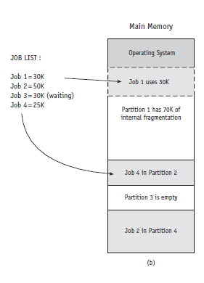

Slide 7
